Slide 1

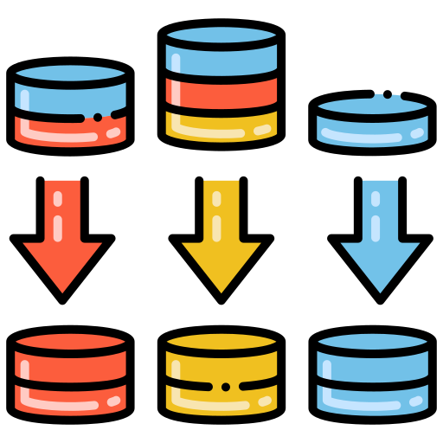
Cardinality & Normalization
mintesnot

Slide 2

What is Normalization?
Unnormalized Form
First Normal Form
Second Normal Form
Third Normal Form
Boyce-Codd Normal Form
Fourth Normal Form
Fifth Normal Form
Sixth Normal Form
Cardinality
Types of Cardinality
Index
View

Slide 3

What is Normalization?
Normalization is the process of organizing data within a database to minimize redundancy and improve data integrity.
The goal is to divide large tables into smaller related tables while maintaining relationships using primary and foreign keys.
Normalization helps:
Eliminate duplicate data
Reduce storage requirements
Improve consistency
Simplify maintenance

Slide 4
Unnormalized Form (UNF)
An unnormalized table contains repeating groups or multiple values in a single column.
Characteristics
Duplicate data is common.
Multiple values may exist in a single field.
Difficult to query and maintain.
High risk of data inconsistency.
Solution
Split repeating values into separate rows to achieve First Normal Form (1NF).

Slide 5
First Normal Form (1NF)
A table is in 1NF when:
Each column contains atomic (single) values.
No repeating groups exist.
Every row is uniquely identifiable.
Rules
✓ No multiple values in a single column
✓ No arrays or lists in a field
✓ Unique rows

Slide 6
Second Normal Form (2NF)
A table is in 2NF when:
It is already in 1NF.
All non-key attributes depend on the entire primary key.
Purpose
Eliminates partial dependency.
Reduces duplication
Improves storage efficiency

Slide 7
Third Normal Form (3NF)
A table is in 3NF when:
It is in 2NF.
No transitive dependencies exist.
Transitive Dependency
A non-key column depends on another non-key column.
Benefits
Eliminates transitive dependency
Improves consistency
Simplifies updates

Slide 8
Boyce-Codd Normal Form (BCNF)
BCNF is a stronger version of 3NF.
Rule
For every functional dependency:
X → Y
X must be a candidate key.
Benefits
Removes additional redundancy
Eliminates complex anomalies
Provides stronger data integrity

Slide 9
Fourth Normal Form (4NF)
A table is in 4NF when:
It is in BCNF.
It contains no multivalued dependencies.
Benefits
Removes unnecessary combinations
Reduces redundancy
Improves data management

Slide 10
Fifth Normal Form (5NF)
A table is in 5NF when:
It is already in 4NF.
Join dependencies are eliminated.
Purpose
Ensure that information cannot be decomposed further without losing data.
Benefits
Eliminates join anomalies
Maximizes database consistency
Used in highly complex systems

Slide 11
Sixth Normal Form (6NF)
6NF is an advanced normalization level mainly used in:
Temporal databases
Data warehouses
Historical tracking systems
Characteristics
Tables contain only key and one non-key attribute.
Eliminates all remaining redundancies.
Benefits
Excellent historical data tracking
Simplifies temporal analysis
Supports highly granular data storage
Limitation
Creates many tables and complex joins.

Slide 12
Normalization Types Comparison Table
Normal Form | Full Name | Main Object | Rule | Removes
UNF | Unnormalized Form | Raw data storage | Data may contain repeating groups and multiple values in a column | None
1NF | First Normal Form | Create atomic values | Each column contains a single value; no repeating groups | Repeating groups
2NF | Second Normal Form | Remove partial dependencies | Must be in 1NF; all non-key attributes depend on the entire primary key | Partial dependencies
3NF | Third Normal Form | Remove transitive dependencies | Must in 2NF; non-key attributes depend only on the primary key | Transitive dependencies
BCNF | Boyce-Codd Norm Form | Stronger version of 3NF | Every determinant must be a candidate key | Remaining dependency anomalies
4NF | Fourth Normal Form | Remove multivalued dependencies | Must be in BCNF; no independent multivalued attributes | Multivalued dependencies
5NF | Fifth Normal Form | Remove join dependencies | Must be in 4NF; avoid redundant joins | Join dependencies

Slide 13
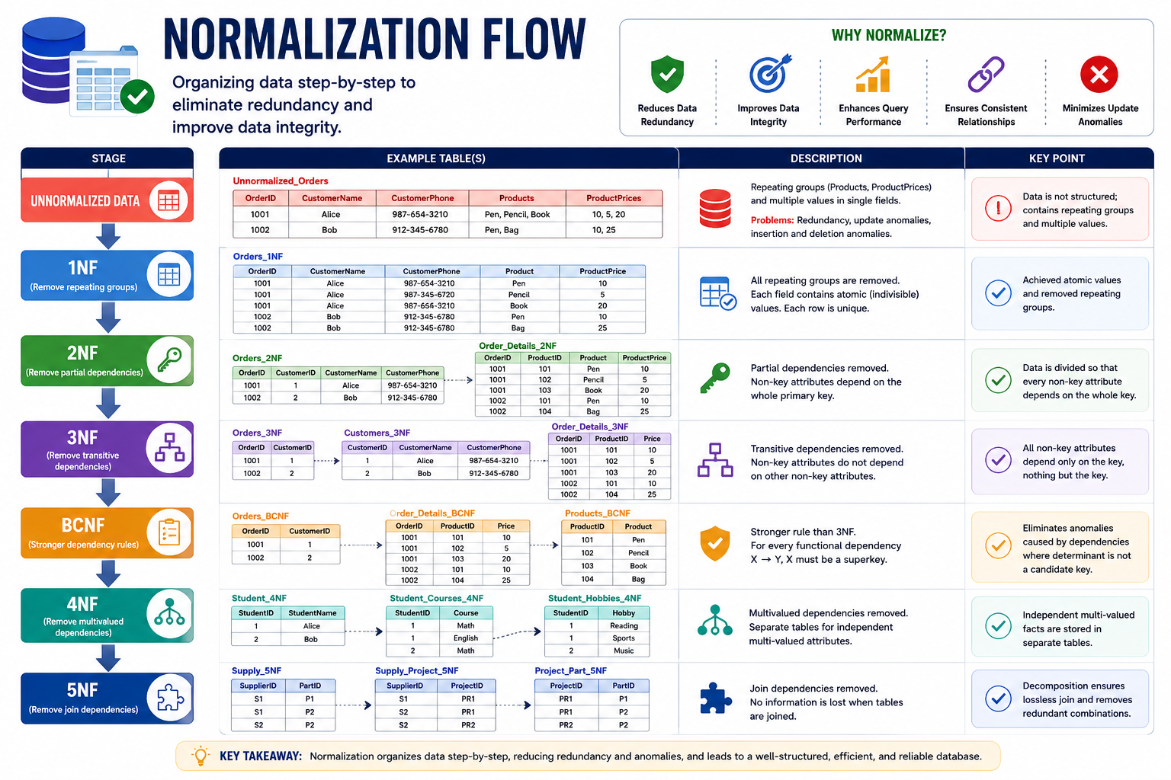
Normalization Flow
UNNORMALIZED DATA
↓
1NF
(Remove repeating groups)
↓
2NF
(Remove partial dependencies)
↓
3NF
(Remove transitive dependencies)
↓
BCNF
(Stronger dependency rules)
↓
4NF
(Remove multivalued dependencies)
↓
5NF
(Remove join dependencies)

Slide 14
When to Denormalize?
Denormalization
Sometimes databases intentionally violate normalization rules to improve performance.
Common Scenarios
Data Warehousing
Reporting Systems
Business Intelligence
Analytics Dashboards
High-Speed Read Operations

Slide 15
Trade-Off
Normalization | Denormalization
Less redundancy | More redundancy
Better integrity | Faster reads
More joins | Fewer joins
Easier maintenance | Better reporting performance
Conclusion
Normalization is essential for designing efficient, consistent, and maintainable relational databases. Most OLTP systems are designed up to 3NF or BCNF, while higher normal forms are used for specialized database applications.

Slide 16

What is Cardinality?
Cardinality defines the relationship between tables in a relational database.
It specifies how many instances of one entity can be associated with instances of another entity.
It helps determine how tables should be structured and connected using primary and foreign keys.
Proper cardinality ensures:
Data consistency
Efficient querying
Reduced redundancy
Accurate representation of real-world business rules

Slide 17

Why Cardinality is important?
Cardinality helps database designers:
Define relationships between entities.
Determine where foreign keys should be placed.
Prevent duplicate or inconsistent data.
Improve database integrity.
Create efficient and scalable database structures.
Without proper cardinality, databases may contain redundant data, inconsistent records, and complex queries.

Slide 18
Cardinality Types
Cardinality Type | Description | Example
One-to-One (1:1) | Each row in Table A matches one row in Table B. | One employee record linked to one employee profile.
One-to-Many (1:N) | One row in Table A can match multiple rows in Table B. | One customer placing multiple orders.
Many-to-One (N:1) | Multiple rows in Table A match one row in Table B. | Many transactions linked to one branch.
Many-to-Many (M:N) | Multiple rows in both tables can match multiple rows in the other. | Products sold in multiple stores with varying suppliers.

Slide 19
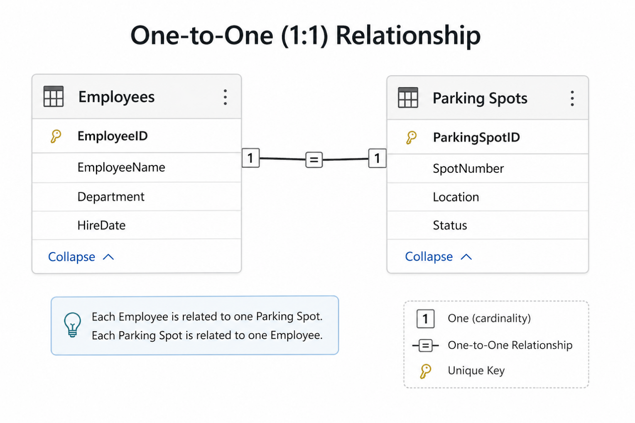
… One-to-One (1:1) Relationship
One-to-One (1:1)
Definition: A single record in Table A is related to a single record in Table B.
Example: Each employee in an organization has on designated parking sport.
Representation:
Table A: Employees
Table B: Parking Spots

Slide 20
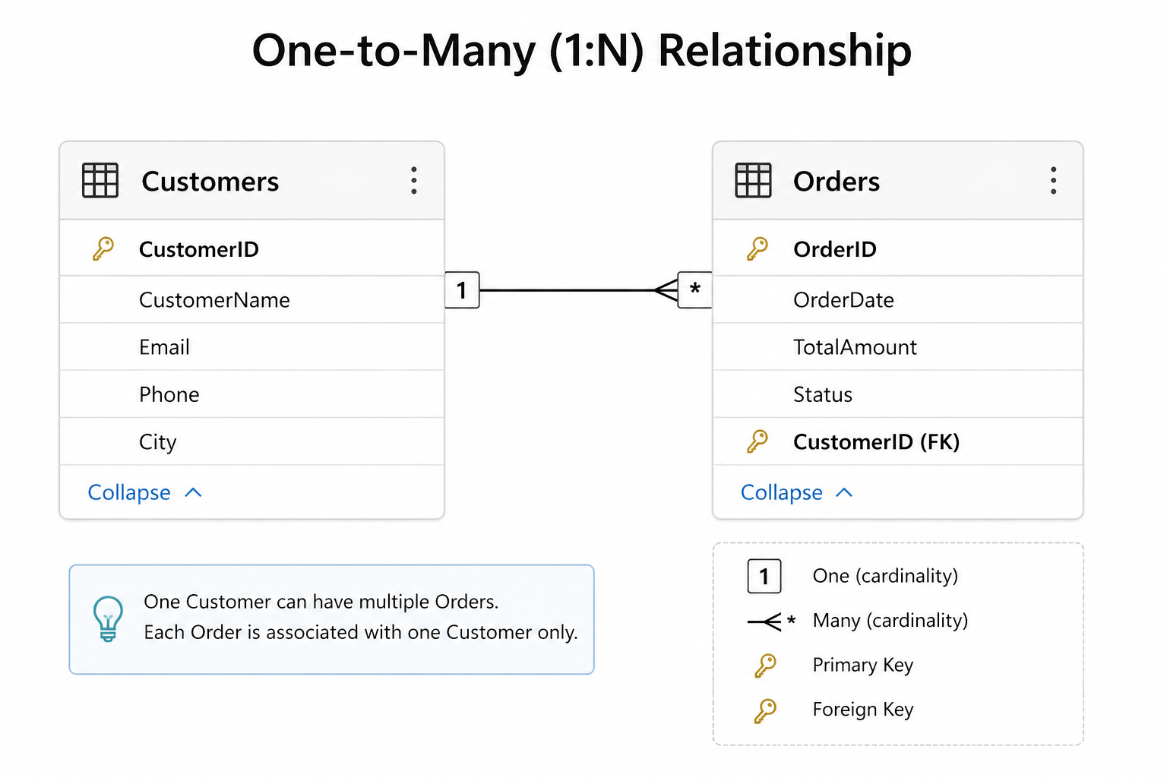
… One-to-Many (1:N) Relationship
One-to-Many (1:N)
Definition: A single record in Table A can be associated with multiple records in Table B, but each record in Table B is linked to only one record in Table A.
Example: A customer can place multiple order, but each order is linked to only one customer.
Representation:
Table A: Customers
Table B: Orders

Slide 21
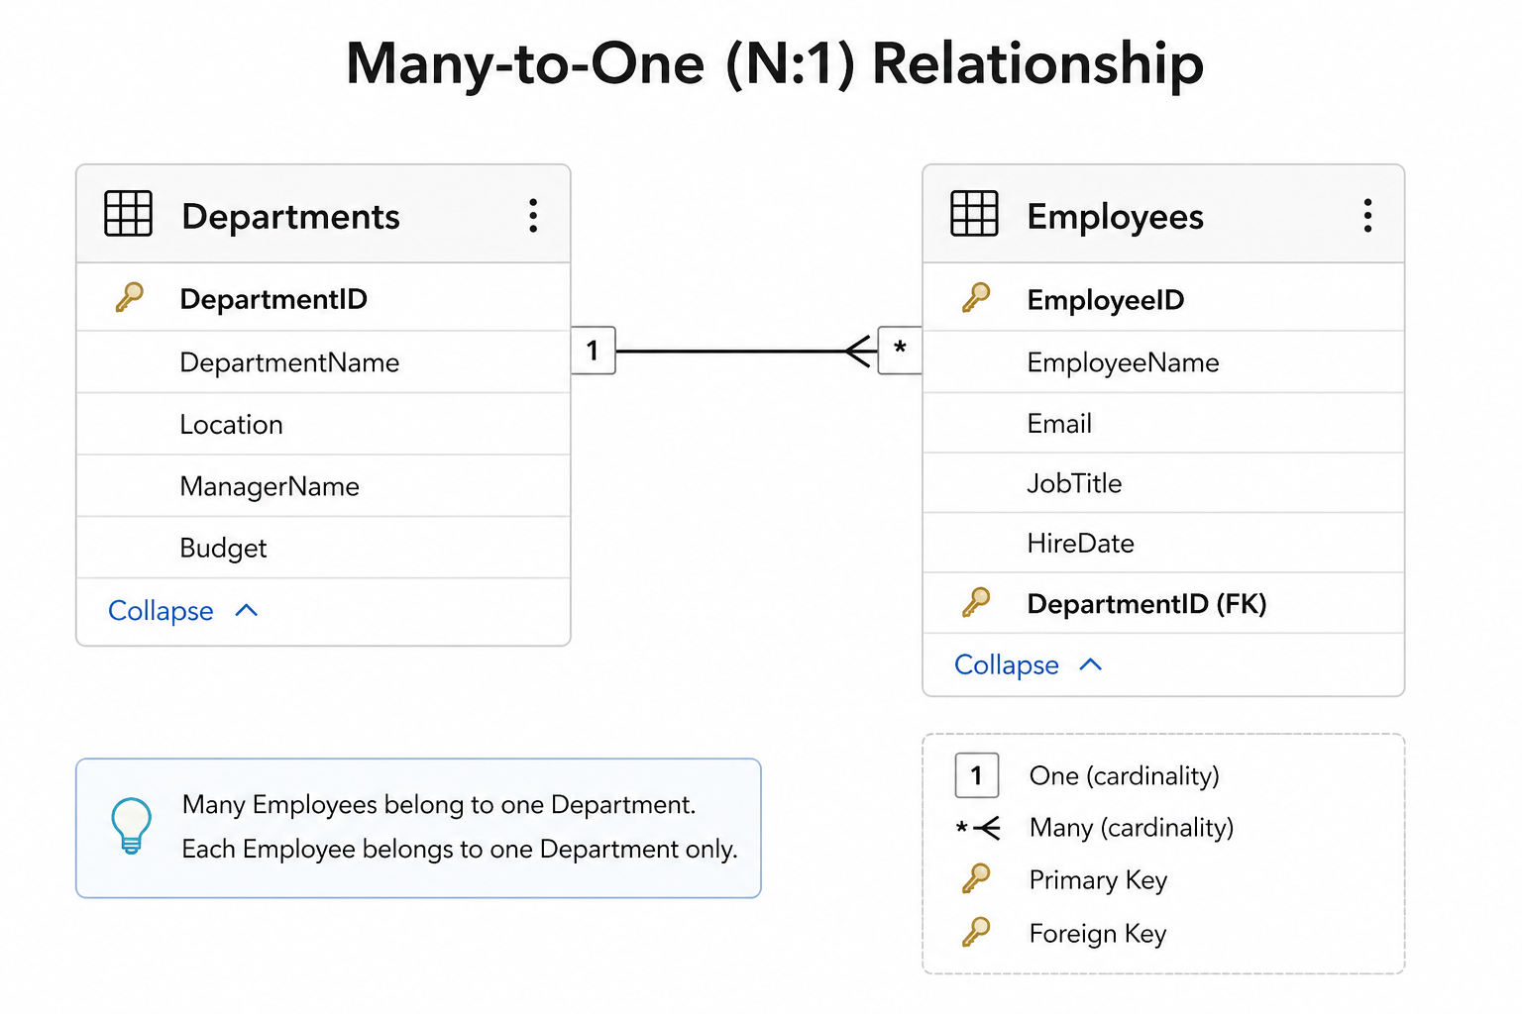
… Many-to-One (N:1) Relationship
Many-to-One (N:1)
Definition: This is essentially the inverse of a one-to-many relationship, where multiple records in Table B can relate to a single record in Table A.
Example: Multiple employees belong to one department.
Representation:
Table A: Departments
Table B: Employees

Slide 22
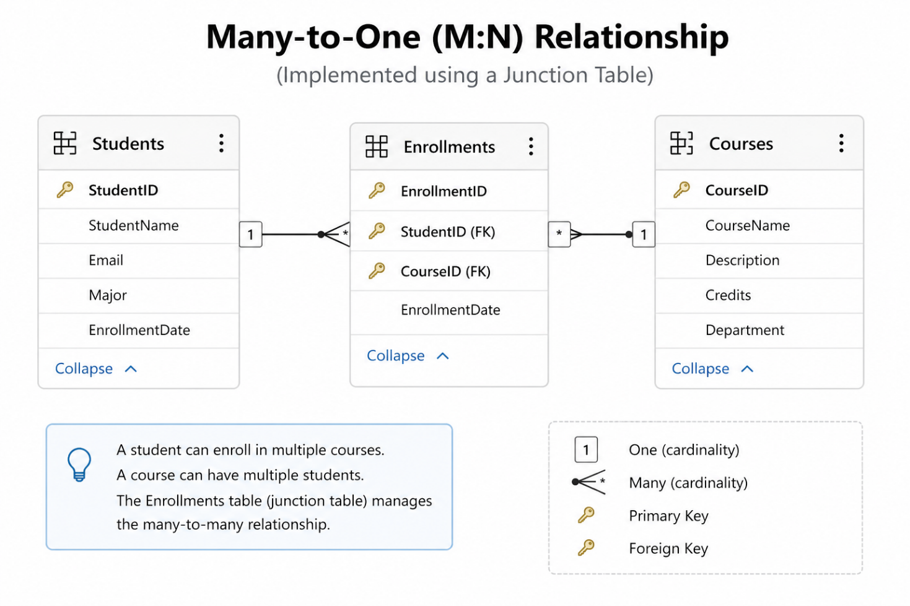
… Many-to-Many (M:N) Relationship
Many-to-One (M:N)
Definition: Records in Table A can relate to multiple records in Table B, and records Table B can relate to multiple records in Table A. This relationship often requires a junction table to manage the associations.
Example: Students and courses; a student can enroll in multiple courses; each course can have multiple students.
Representation:
Table A: Departments
Table B: Employees

Slide 23
What is an Index?
An Index is a database object that improves the speed of data retrieval operations by creating a fast lookup structure for one or more columns.
Think of an index like the index at the back of a textbook—instead of reading every page, you quickly locate the information you need.
Benefits
⚡ Faster SELECT queries
📈 Improved search performance
🔍 Faster sorting (ORDER BY)
🔗 Faster joins
🎯 Efficient filtering with WHERE

Slide 24
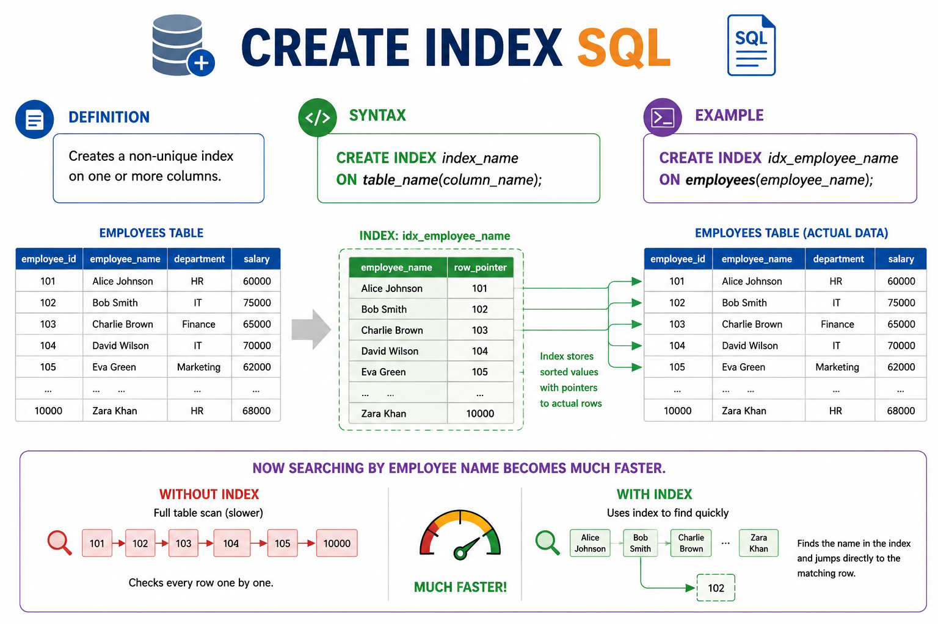
Create index
Creates a non-unique index on one or more columns.
Syntax
CREATE INDEX index_name ON table_name(column_name);
Example
CREATE INDEX idx_employee_name ON employees(employee_name);

Slide 25
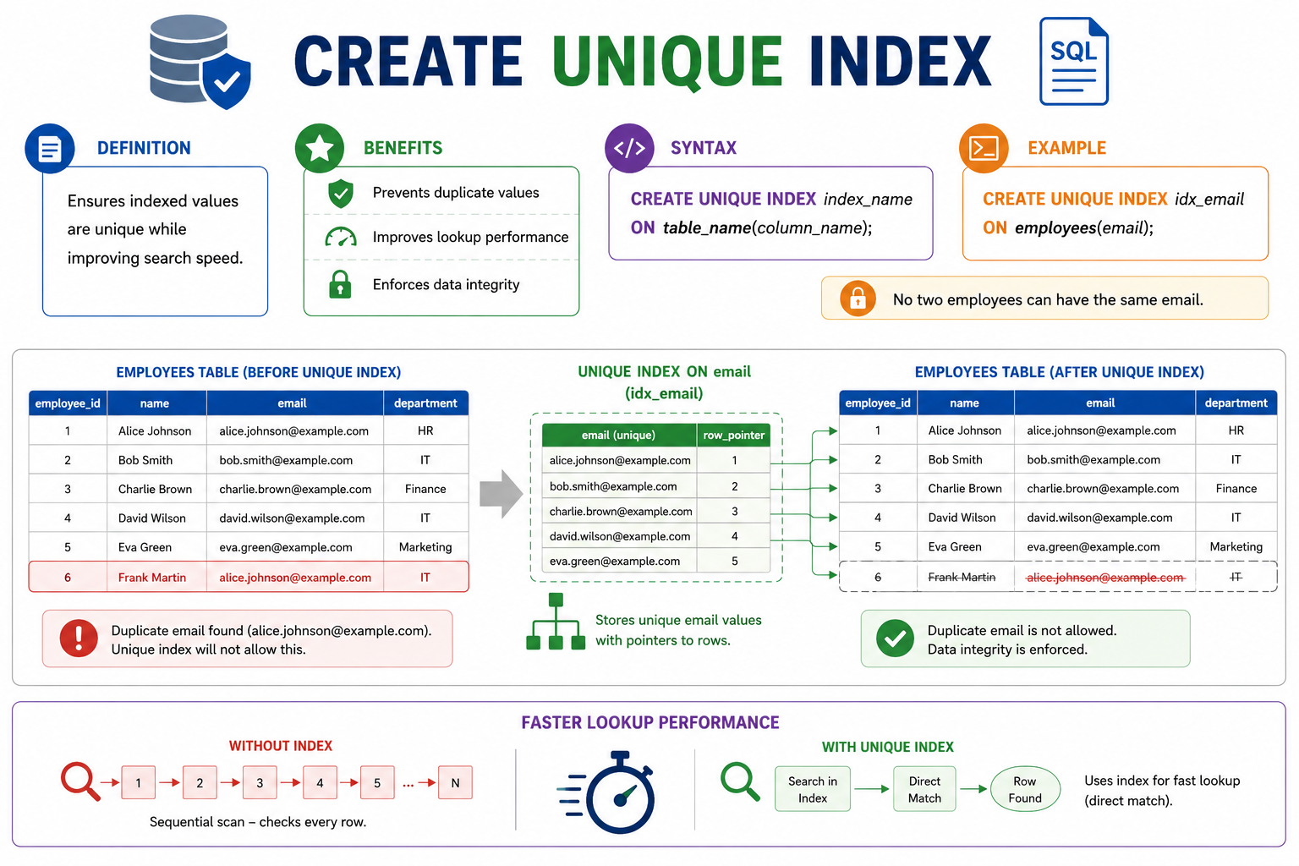
Create unique index
Ensures indexed values are unique while improving search speed.
Benefits
Prevents duplicate values
Improves lookup performance
Enforces data integrity
Syntax
CREATE UNIQUE INDEX index_name ON table_name(column_name);
Example
CREATE UNIQUE INDEX idx_email ON employees(email);
No two employees can have the same email.

Slide 26
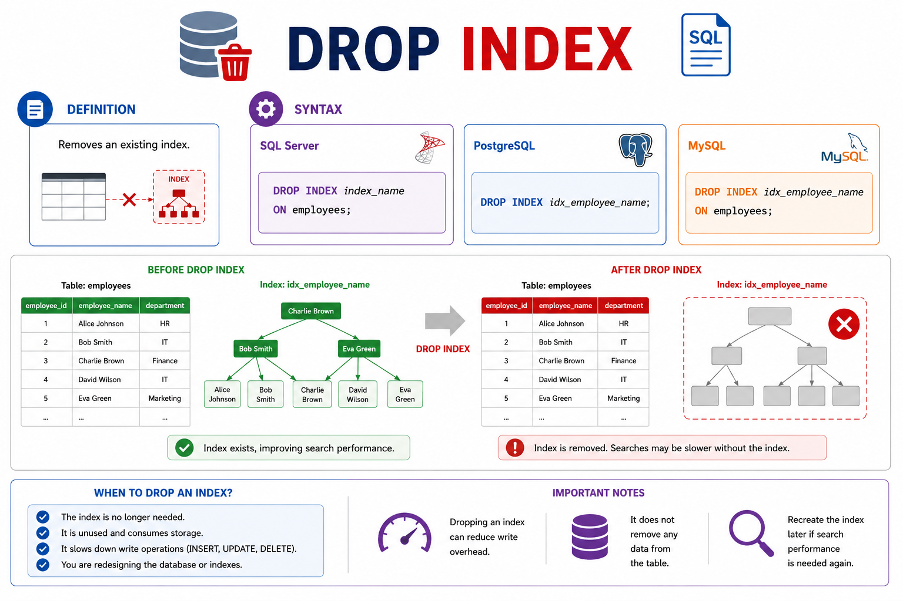
Drop index
Removes an existing index.
SQL Server
DROP INDEX index_name ON employees;
PostgreSQL
DROP INDEX idx_employee_name;
MySQL
DROP INDEX idx_employee_name ON employees;

Slide 27
What is a View?
A View is a virtual table created from one or more SQL queries.
It stores the SQL query—not the actual data (except for materialized views).
Benefits
Simplifies complex queries
Improves security
Reuses SQL code
Hides sensitive columns
Easier reporting

Slide 28
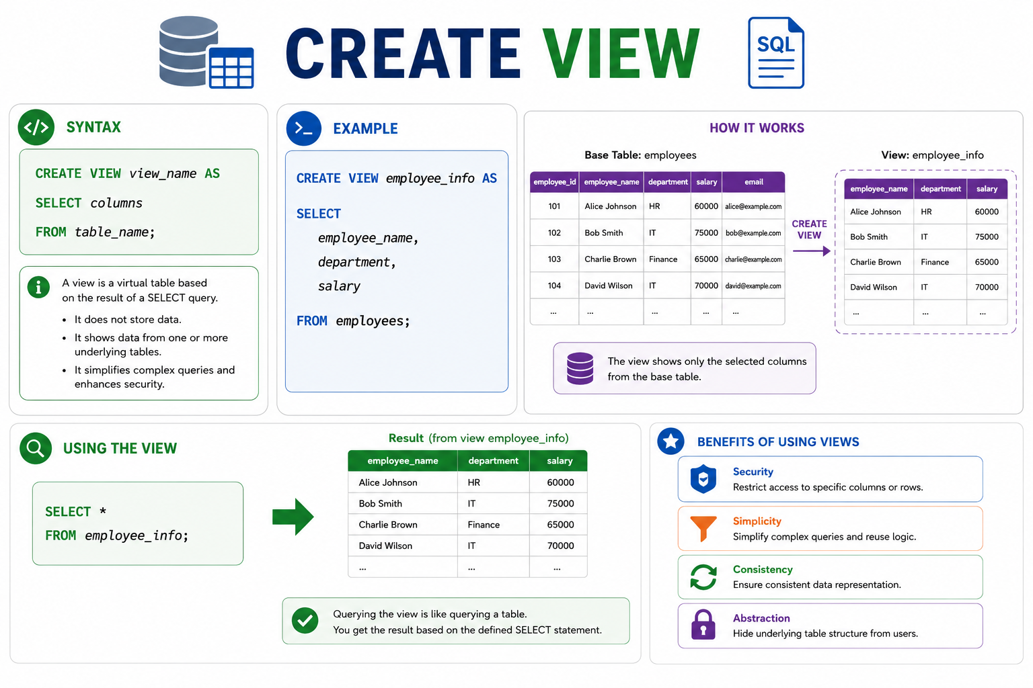
Create view
Syntax
CREATE VIEW view_name AS SELECT columns FROM table_name;
Example
CREATE VIEW employee_info AS SELECT employee_name, department, salary FROM employees;
Using the view
SELECT * FROM employee_info;

Slide 29
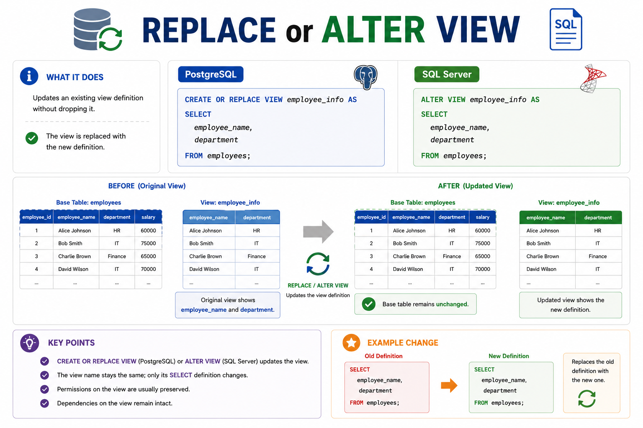
Replace or Alter view
PostgreSQL
CREATE OR REPLACE VIEW employee_info AS SELECT employee_name, department FROM employees;
SQL Server
ALTER VIEW employee_info AS SELECT employee_name, department FROM employees;

Slide 30
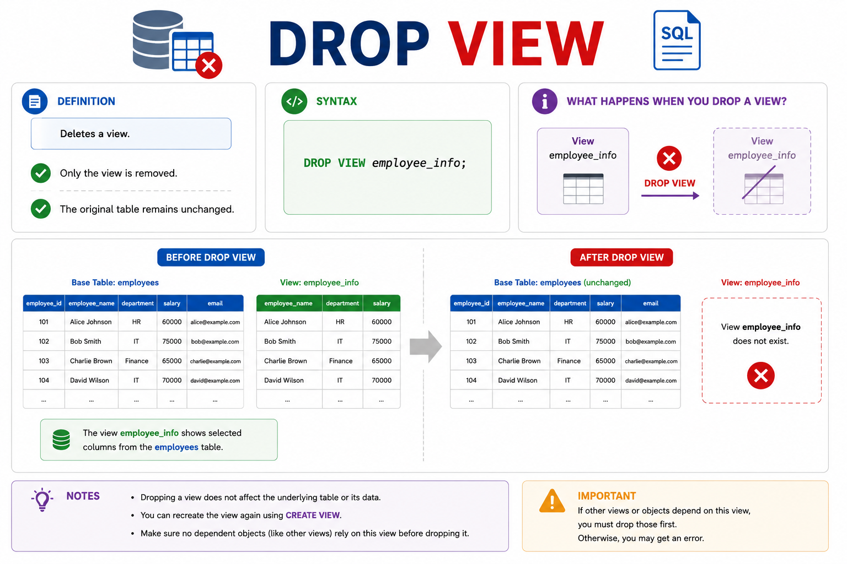
Drop view
Deletes a view.
Syntax
DROP VIEW employee_info;
Only the view is removed.
The original table remains unchanged.

Slide 31
View Vs. Table
Feature | View | Table
Store data | ❌ Usually No | ✅ Yes
Virtual | ✅ Yes | ❌ No
Can join multiple tables | ✅ Yes | ❌ No
Takes storage | Very little | Yes
Used for reporting | ✅ Yes | Sometimes
Supports security | ✅ Yes | Limited

